Slide 1
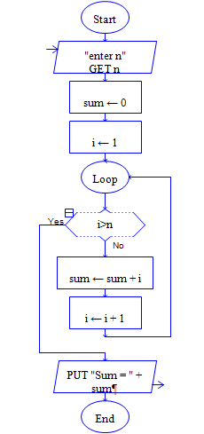
Flowchart to find sum of natural numbers

Slide 2
Program to find the sum of natural numbers up to N
#include <iostream.h>
#include<conio.h>
void main( )
{
int n;
int sum = 0;
int i=1;
clrscr();
cout<<“Enter a value for n : “;
cin>>n;
while(i<=n)
{
sum= sum+i
i=i+1;
}
]h cout<<sum;
getch();
}

Slide 3
To print all even numbers up to a given limit N.
#include<iostream.h>
#include<conio.h>
void main()
{
int limit, i;
clrscr();
cout<<"Enter the limit\n";
cin>>limit;
for(i=2; i<=limit; i++)
{
if((i%2) == 0)
{
cout<<i<<"\t";
}
}
getch();
}

Slide 4
Reverse an ‘N’ digit number
#include<iostream.h>
#include<conio.h>
void main()
{
int n,rev=0;
clrscr();
cout<<"Enter a number\n";
cin>>n;
while(n!=0)
{
rev = (10 * rev) + n%10;
n = n/10;
}
cout<<”Reversed no.=\n"<<rev;
getch();
}

Slide 5
Convert binary to decimal
e.g.-given n=101 → 1*2² + 0*2¹ + 1*2⁰ = 5
---------------------------------------------------------------------------------------------------
#include<iostream.h>
#include<conio.h>
#include<math.h>
void main()
{
int n, p=0, sum=0, k;
cout<<"Enter a binary number : ";
cin>>n;
do {
k=n%10; // binary number in n
sum= sum + k * pow(2,p); //decimal number in sum
p++;
n= n/10;
} while (n!=0);
cout<<"\n"<<"Decimal Equivalent = " <<sum;
getch();

Slide 6
Generate the Fibonacci series up to the given limit. [Hint: for N=7; Fibonacci series is 0, 1, 1, 2, 3, 5, 8]
#include<iostream.h>
#include<conio.h>
void main()
{ clrscr();
int a=0,b=1,c=0,n;
cout<<"Enter the number of terms: ";
cin>>n;
cout<<a<<" "<<b<<" ";
for(int i=1;i<=n-2;i++)
{
c=a+b;
a=b;
b=c;
cout<<c<<" ";
}
getch();
}

Slide 7
Generate the multiplication table for ‘n’ numbers up to ‘k’ terms
#include<iostream.h>
#include<conio.h>
void main()
{
int n,k,i,j,prod;
cout<<"Enter the number\n";
cin>>n;
cout<<"Enter the term\n";
cin>>k;
for (i=1; i<=k; i++) //for term
{
for (j=1; j<=n; j++) //for number
{
prod = i * j;
cout<< j << " * " << i <<"= "<< prod <<"\t";
}
cout<<“\n”;
}
getch();
}
Enter n & k values: 3 5
The table for 3 X 5 is
1 * 1= 1 2 * 1= 2 3 * 1= 3
1 * 2= 2 2 * 2= 4 3 * 2= 6
1 * 3= 3 2 * 3= 6 3 * 3= 9
1 * 4= 4 2 * 4= 8 3 * 4= 12
1 * 5= 5 2 * 5= 10 3 * 5= 15

